Slide 1
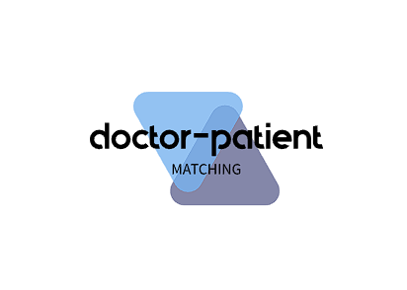

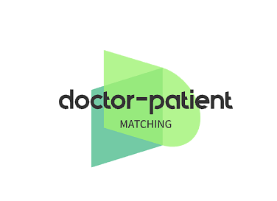
BY TECHNOCRAFTS

Slide 2

Basic Details and Problem statement
Problem statement: -Doctor-patient Matching
Build a platform that matches patients with the most suitable doctors based on their needs, location and Doctor speciality.
Theme: MedTech
Team members:
Bhavesh Reddy
CH Pushpak Hanish
Eshaan Michael
Sai Aasrith
Team Leader: Bhavesh Reddy
Institute Name: Woxsen University

Slide 3
What is Doctor-patient matching ?
Patient-physician connection, also known as patient-provider connection or physician-patient connection, is the process of connecting a patient with the appropriate doctor (healthcare provider) or physician.
Doctor-patient matching takes into account a number of factors, such as the patient's health status, preferences, location, health care provider's expertise, and availability.
It aims to ensure that patients receive appropriate and timely health services by connecting them with the most appropriate health professionals, whether in primary care, specialist treatment or specific medical needs.

Slide 4
Why Doctor-patient Matching Important ?
Improved Quality of Care
Patient Satisfaction
Reduced Wait time
Cost- Efficient
Preventive care
Remote access
Patient preferences

Slide 5
Challenges to find a Right Doctor
Limited Information: Patients often have limited information about available doctors, their qualifications, and their specialties. This lack of information can make it difficult to make an informed choice.
Geographic Limitations: Depending on their location, patients may have limited access to doctors, especially specialists. In rural or remote areas, the options for healthcare providers may be scarce.
Overcrowded Healthcare Systems: In densely populated areas, healthcare systems can be overcrowded, leading to long wait times for appointments and reduced availability of preferred doctors.

Slide 6
Challenges to find a Right doctor
Availability and Scheduling: Some doctors have limited availability or operate on a part-time basis. Patients may struggle to schedule appointments that suit their own availability.
Specialty and Expertise: Patients with specific medical conditions require specialists with the appropriate expertise. Finding the right specialist can be challenging, particularly if they are in high demand or not located nearby.

Slide 7
Use of Doctor-patient matching
Improved Care Coordination: Patient matching systems help ensure that patient health records are accurately linked to the right individual. This promotes better care coordination as healthcare providers have access to a patient's complete medical history, leading to more informed and effective treatment decisions
Enhanced Patient Experience: When patient records are readily accessible and accurate, it streamlines the registration and check-in process, reducing patient wait times and administrative hassles. This contributes to a more positive and efficient healthcare experience.

Slide 8
Use of Patient-Doctor matching
Personalized Medicine: Improved patient matching enables healthcare providers to tailor treatment plans and interventions to the patient's unique medical history, preferences, and needs, promoting personalized medicine.
Timely Access to Care: Patients can access appropriate healthcare services more quickly when their records are accurately matched with the right provider. This can be especially critical in emergency situations or when seeking specialized care

Slide 9


Front end software’s
HTML
CSS
JAVASCRIPTS
BACKEND SOFTWARE’S (DATABASE)
FIREBASE

Slide 10
Goals
The goal of creating a doctor-patient matching system is to improve the healthcare experience for both patients and healthcare providers. This system aims to connect patients with the most suitable healthcare providers based on various factors and preferences. Here are some key objectives.
To achieve these goals, doctor-patient matching systems may use algorithms, data analysis, and patient input to make informed recommendations for healthcare provider selection. These systems can be implemented as standalone platforms, integrated into electronic health records (EHR) systems, or offered as features within healthcare provider directories and booking services.

Slide 11
PROGRESS
1.Named our website as Doc-Connect
2.Created doctor registration page
3.Data input by patient
4.Created database

Slide 12

Upcoming upgrades for the future
Addition of navigation features
Addition of data
Real-time Feedback
Electronic Health Records
Slot booking

